Slide 2
Clinical Case Study 1

Slide 3
Clinical Case Studies
Now that you have learned about the 3A’s Framework for Firearm Injury Prevention Counseling, it’s time to put them into practice.
Here are three case scenario videos highlighting different clinical scenarios where firearms pose a risk.
To play each video clip (e.g. Case Study 2: Clip 1), turn on slideshow mode and click on the link in the title to play the clip directly in YouTube or embed the video into your own slide sets.
There will be a series of questions for each case along with talking points to guide the discussion.

Slide 4
Case Study 1
Notes:
Hilary

Slide 5
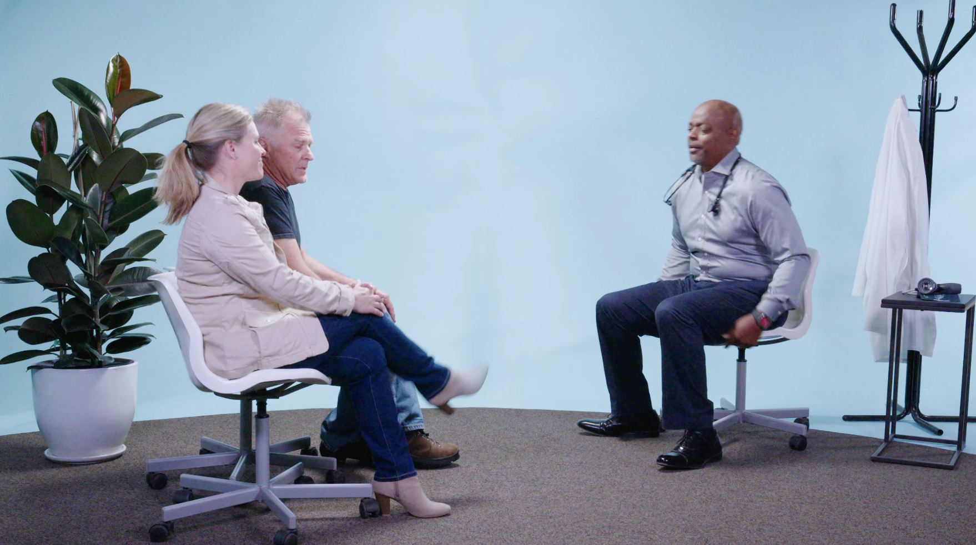
Case Study 1: Clip 1

Slide 6
What risk factors are present here?
Notes:
Alcohol use (substance misuse)
Depression
Some cognitive impairment
Relationship loss

Slide 7
On a scale from no risk (0) to very high risk (10), how would you rate the level of risk in this case?
Notes:
Low to medium risk

Slide 8
What type(s) of harm would you be worried about in this case?
Notes:
Suicide
Unintentional Injury

Slide 9
If you were in Dr. Smith’s shoes, how would you ask Jeff about firearms?
Notes:
Since Jeff is in a demographic at high risk for firearm suicide and he also has other risk factors that are of concern it is clinically relevant to ask him about firearms.
Be sure to use all four elements of the Approach component and frame this conversation in the context of safety using culturally-appropriate and respectful language.

Slide 10
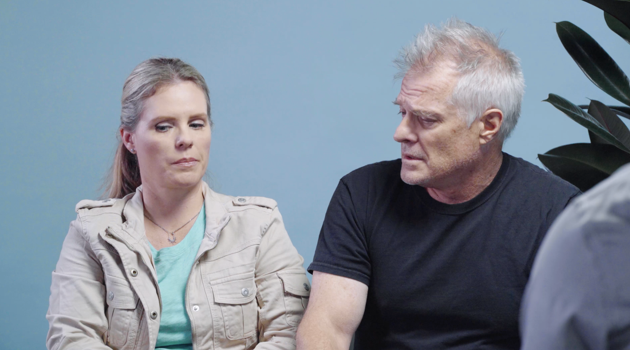
Case Study 1: Clip 2

Slide 11
If you were in Dr. Smith’s shoes, what would you do to reduce the risk of firearm injury?
Notes:
Recommend that Jeff temporarily transfer the firearm/s to someone outside the home
Give Jeff and Susan information about safe storage of firearms

Slide 12
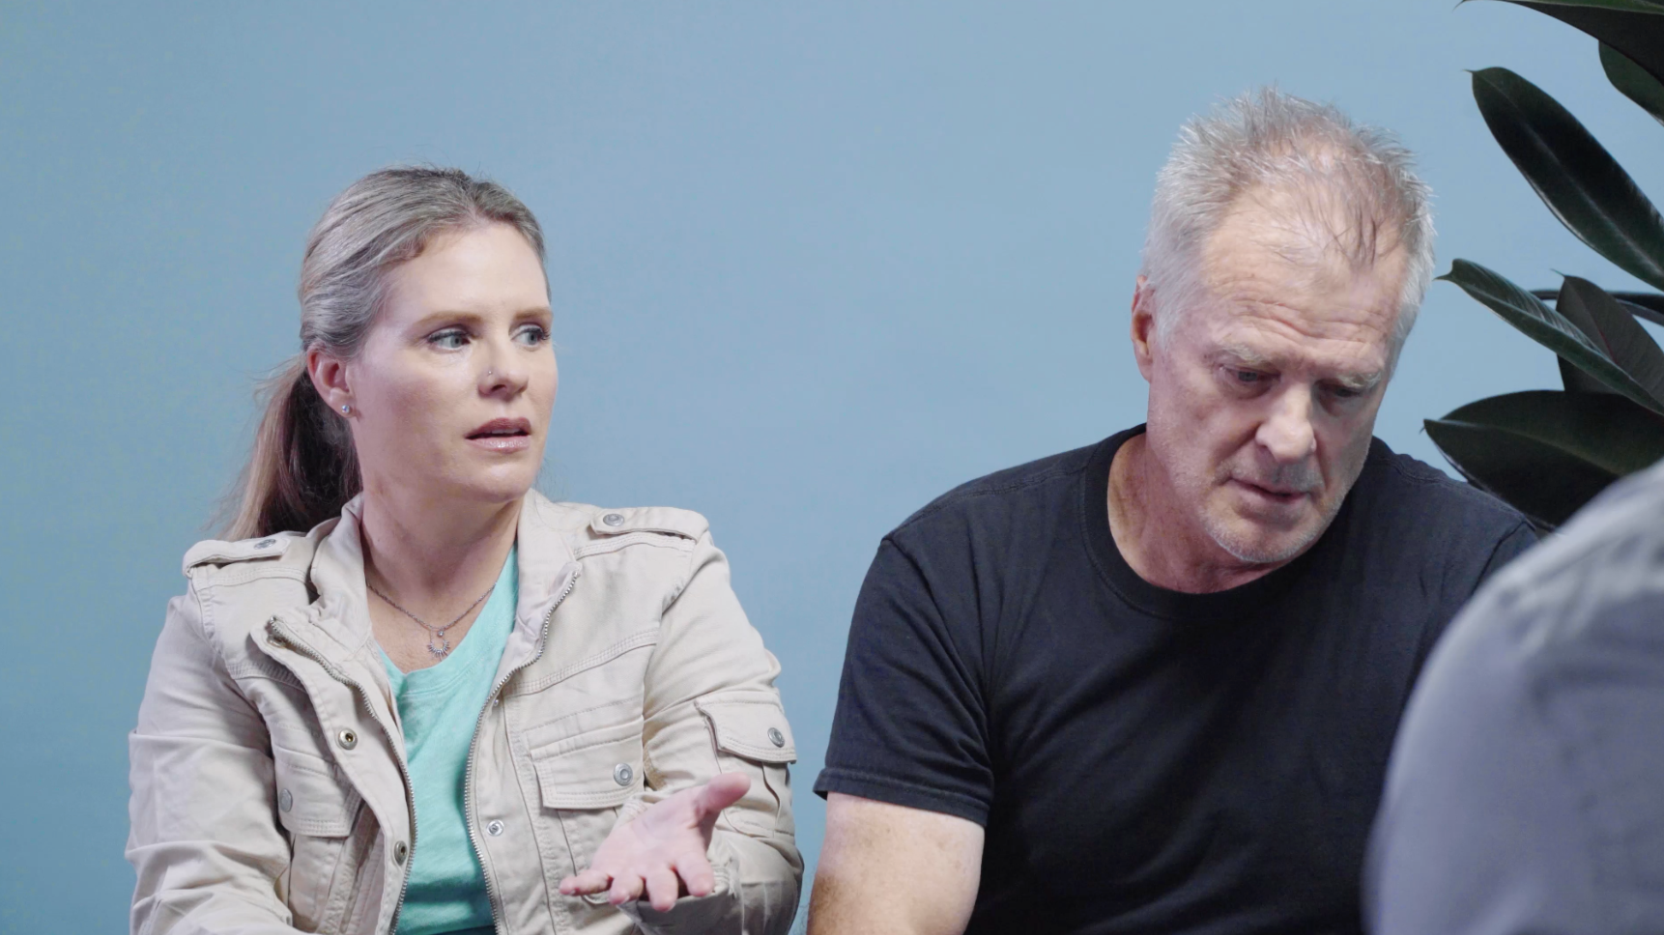
Case Study 1: Clip 3

Slide 13
Now that Jeff is going to transfer his guns to Susan, what else might
Dr. Smith want to know?
Notes:
Does Susan have a plan for safe firearm storage in her home that also prevents unauthorized access by her children?

