Slide 1
Educators Toolkit: Case Study 2

Slide 2
Clinical Case Study 2

Slide 3
Clinical Case Studies
Now that you have learned about the 3A’s Framework for Firearm Injury Prevention Counseling, it’s time to put them into practice.
Here are three case scenario videos highlighting different clinical scenarios where firearms pose a risk.
To play each video clip (e.g. Case Study 2: Clip 1), turn on slideshow mode and click on the link in the title to play the clip directly in YouTube or embed the video into your own slide sets.
There will be a series of questions for each case along with talking points to guide the discussion.

Slide 4
Case Study 2
Notes:
Apurva

Slide 5
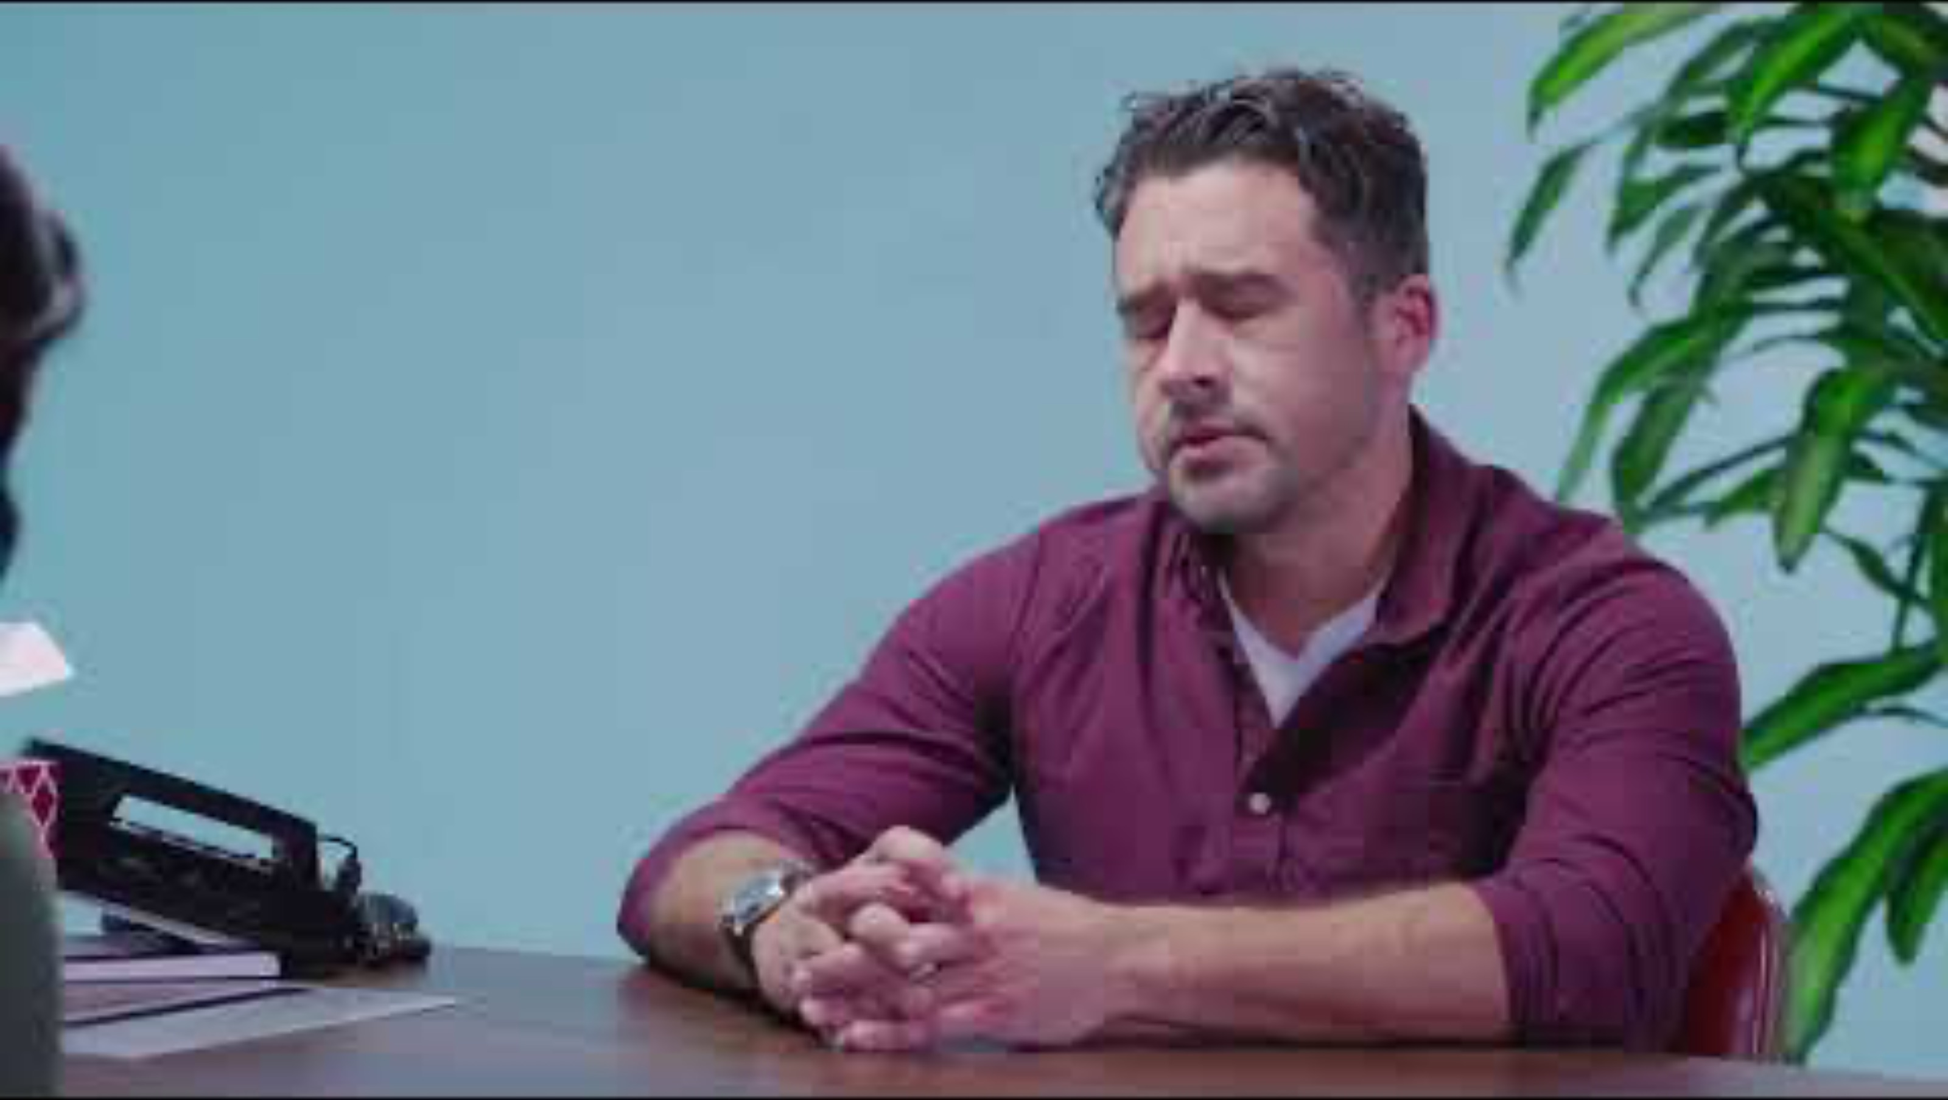
Case Study 2: Clip 1

Slide 6
What risk factors are present here?
Notes:
Young child in the home
Storing guns in a way that they are easily accessible to at-risk people
Depression

Slide 7
On a scale from no risk (0) to very high risk (10), how would you rate the level of risk in this case?
Notes:
Low risk

Slide 8
What type(s) of harm would you be worried about in this case?
Notes:
Unintentional injury

Slide 9
If you were in Julian’s shoes, would you recommend that
Tonya get rid of the gun?
Notes:
No, as a clinician in this scenario it is important to take a harm reduction approach and respect Tonya’s decision to own firearms. Think about proposing steps, including small steps, that will help reduce risk. Sometimes the safest scenario might not be achievable, so a safer scenario is the goal.

Slide 10
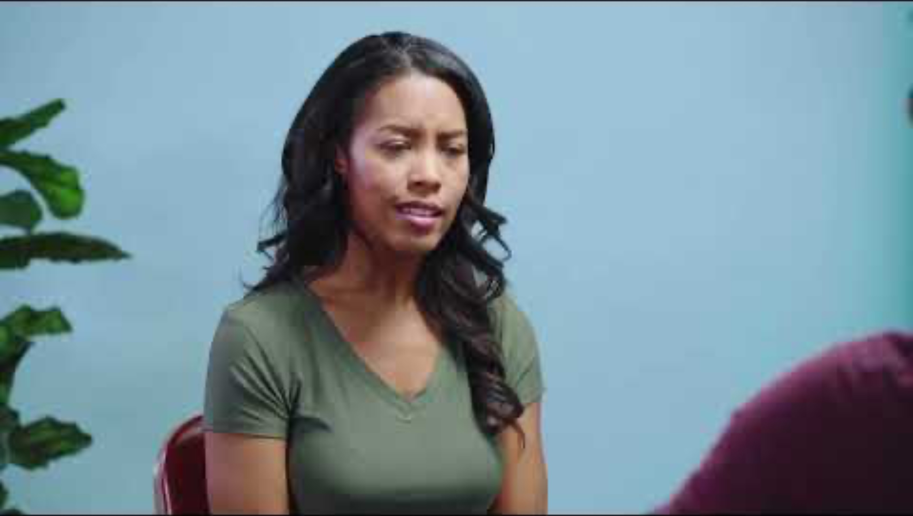
Case Study 2: Clip 2

Slide 11
If you were in Julian’s shoes, what would you do to reduce the risk of firearm injury?
Notes:
Give Tonya information about safe storage of firearms, such as a quick access lockbox
Recommend a training on safe firearm handling

Slide 12
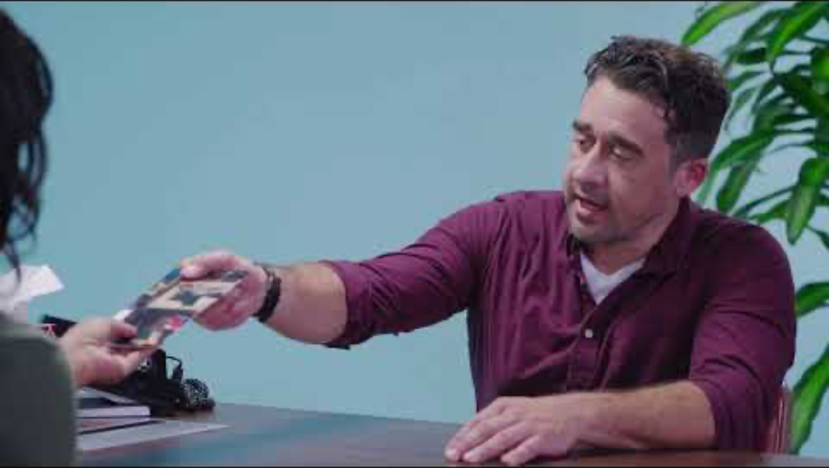
Case Study 2: Clip 3

Slide 13
In this case, Tonya was willing to follow Julian's recommendations. What might you do if a patient weren’t as willing to collaborate?
Notes:
Whenever possible, take a collaborative approach
Respectfully emphasize why access to firearms is clinically relevant
Reinforce the goal, keeping the patient or someone else safe
Explore the patient’s reasons for not wanting to answer or engage
Ensure the patient has access to resources about safer firearm storage
If the risk is non-emergent, defer discussion to a later visit; a patient has the right to not discuss firearm ownership if they so choose

