Slide 2
Clinical Case Study 3

Slide 3
Clinical Case Studies
Now that you have learned about the 3A’s Framework for Firearm Injury Prevention Counseling, it’s time to put them into practice.
Here are three case scenario videos highlighting different clinical scenarios where firearms pose a risk.
To play each video clip (e.g. Case Study 3: Clip 1), turn on slideshow mode and click on the link in the title to play the clip directly in YouTube or embed the video into your own slide sets.
There will be a series of questions for each case along with talking points to guide the discussion.

Slide 4
Case Study 3
Notes:
Hilary

Slide 5
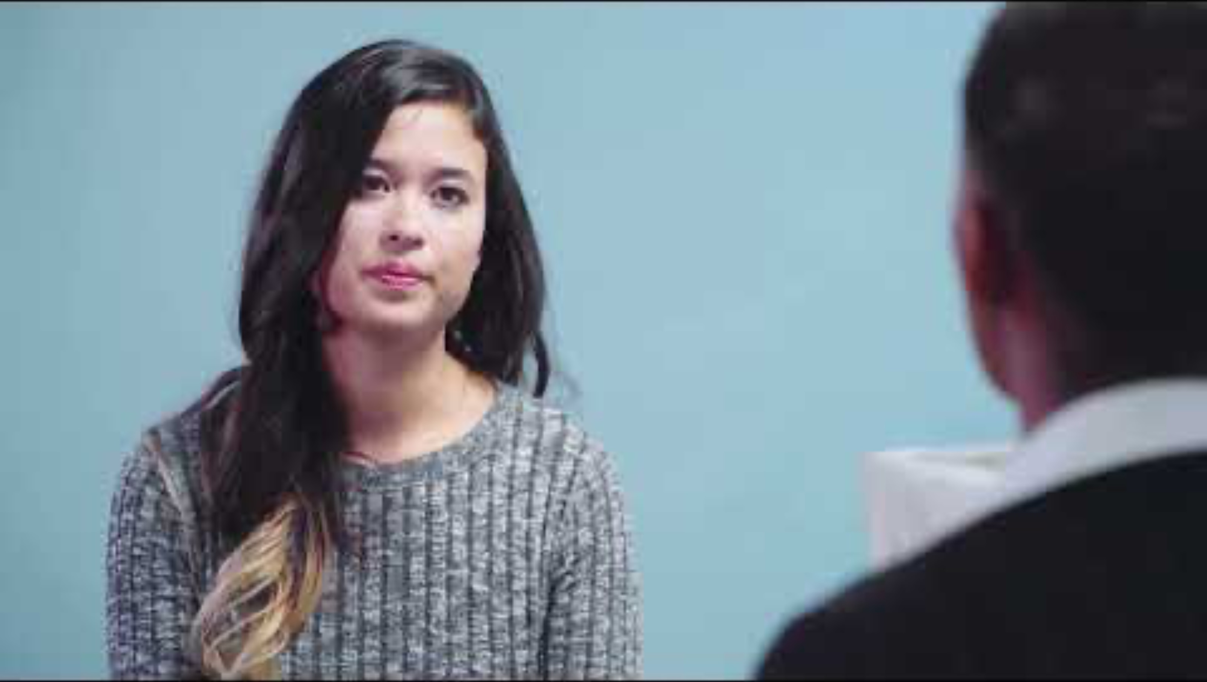
Case Study 3: Clip 1

Slide 6
What risk factors are present here?
Notes:
Domestic violence
Abusive former partner
Recent relationship loss

Slide 7
On a scale from no risk (0) to very high risk (10), how would you rate the level of risk in this case?
Notes:
Very high risk

Slide 8
What type(s) of harm would you be worried about in this case?
Notes:
Homicide
Mass shooting
Intimate partner violence

Slide 9
If you were in Marion’s shoes, what would you do to reduce the risk of firearm injury?
Notes:
Give Deborah information about the domestic violence hotline, connect her to organizations that specialize in helping people escape violent or abusive environments
Give Deborah information about how to file a domestic violence restraining order
Call law enforcement to provide information about the threats and the level of dangerousness to file a civil protective order (extreme risk protection order)

Slide 10
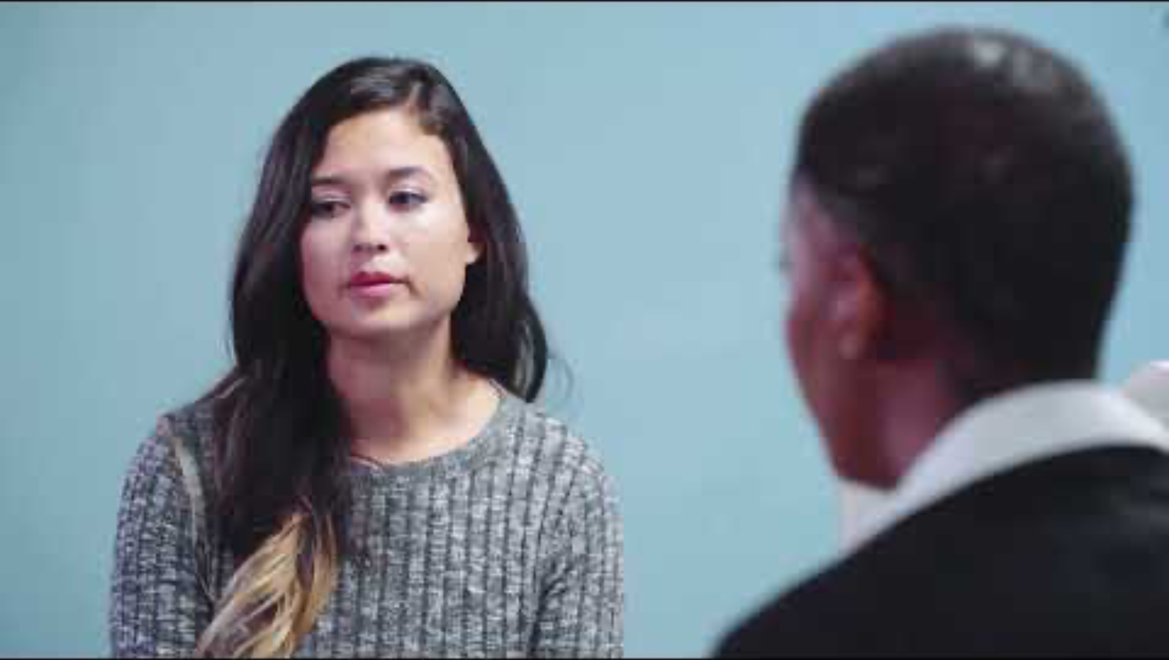
Case Study 3: Clip 2

Slide 11
Is Marion legally allowed to tell law enforcement about the threats made by Deborah’s partner?
Notes:
Yes, in more urgent situations such as Deborah’s in which there is “an immediate and present danger,” providers may be permitted to contact law enforcement.

Slide 12
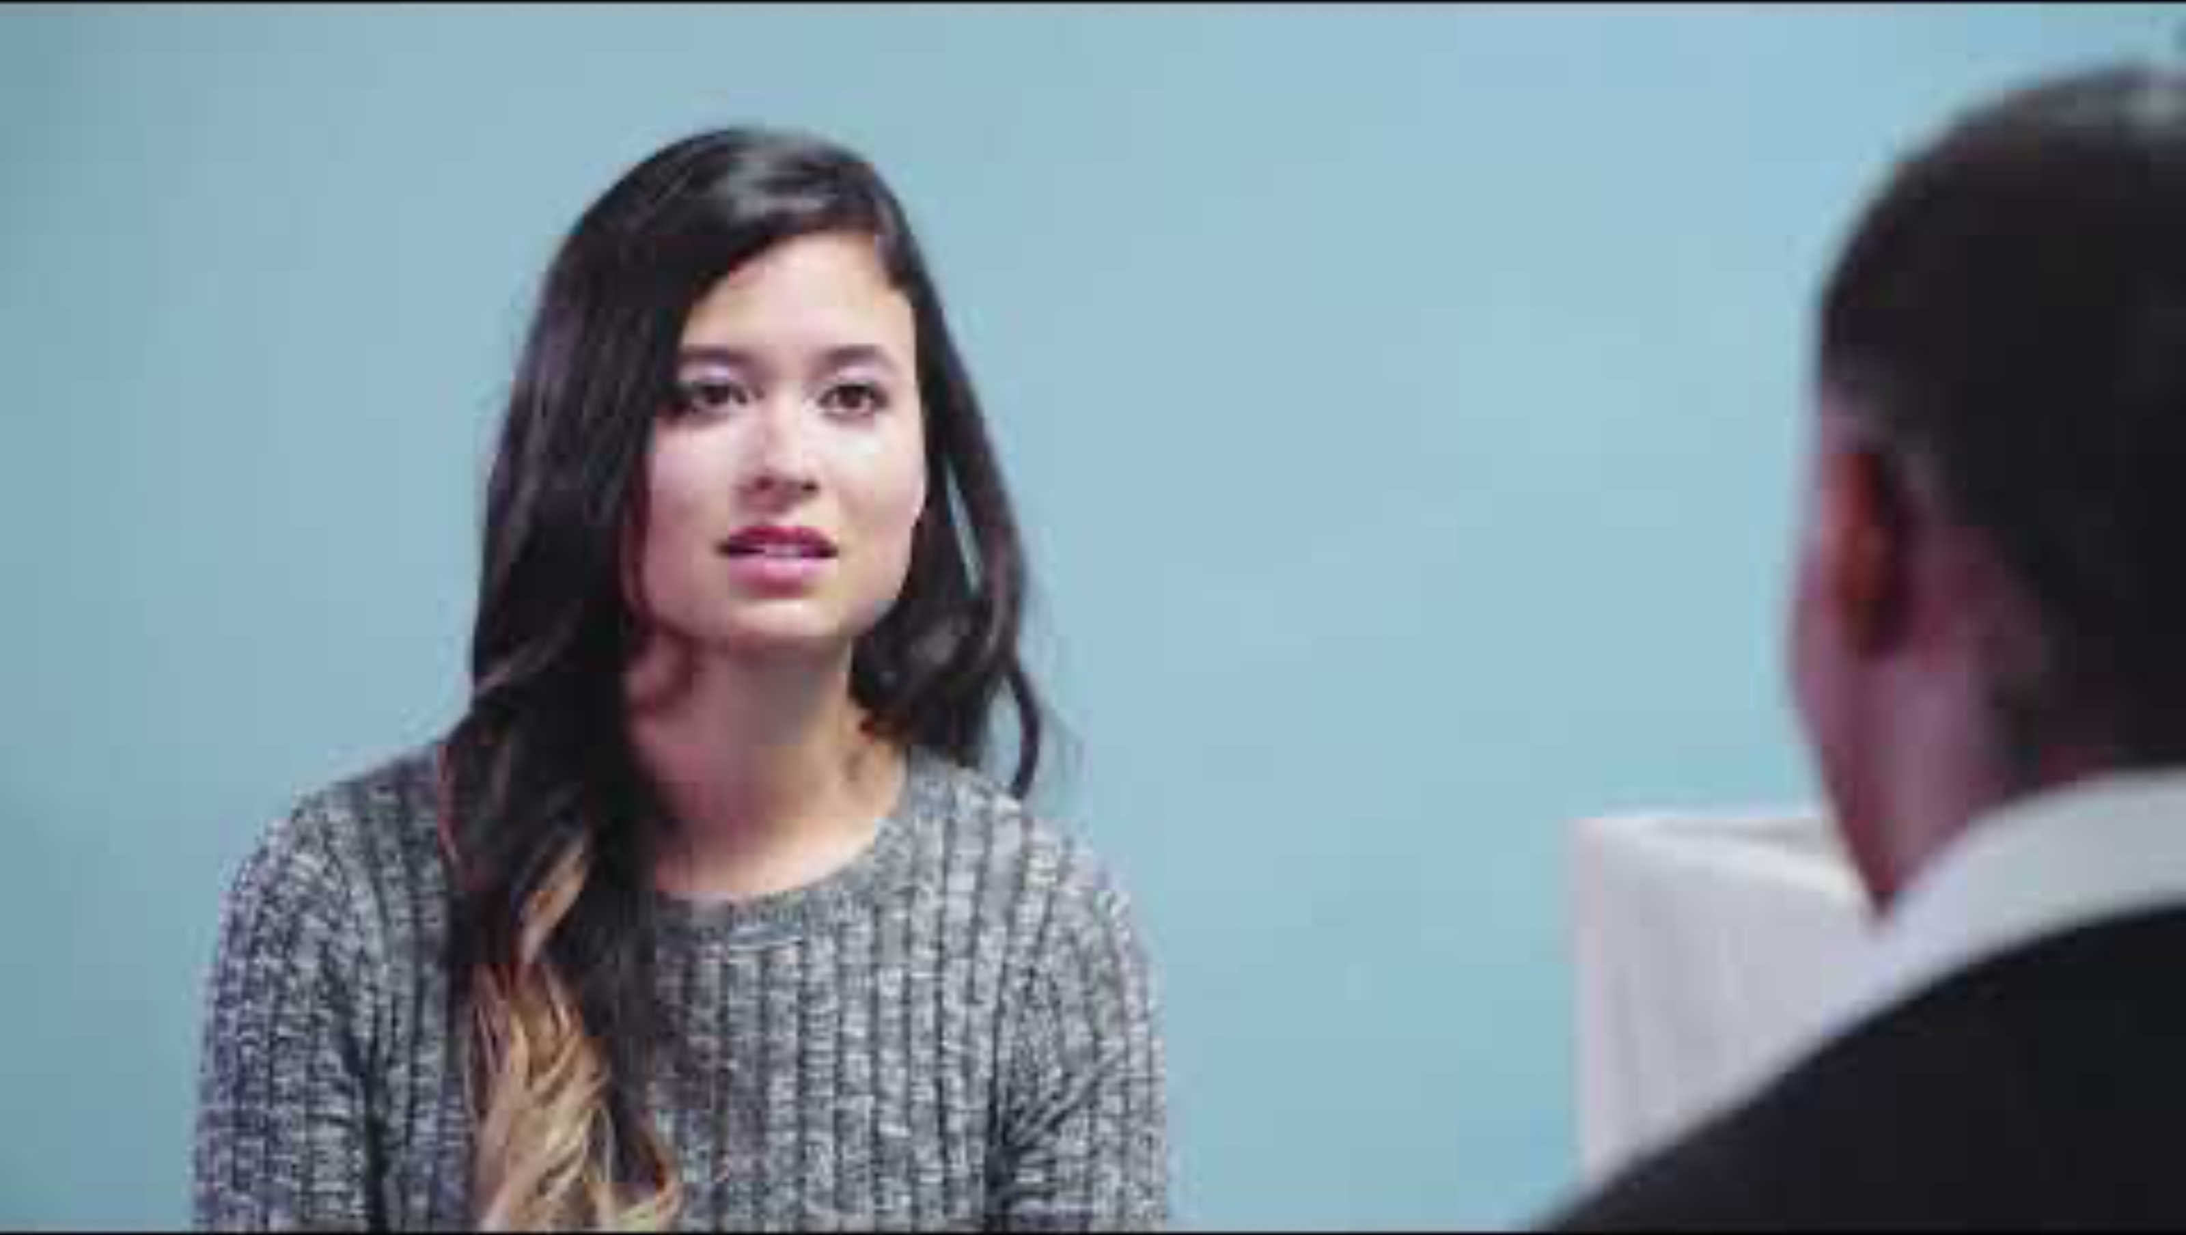
Case Study 3: Clip 3

