Slide 2
The 3A’s Framework for Firearm Injury Prevention Counseling

Slide 3
The Clinician’s Role
Assess risk and, when it’s clinically relevant, talk with patients about risk and firearms, and take action to reduce risk.
There are no state or federal statutes that prohibit clinicians from talking with patients about access to firearms.

Slide 4
The 3A’s Framework

Slide 5
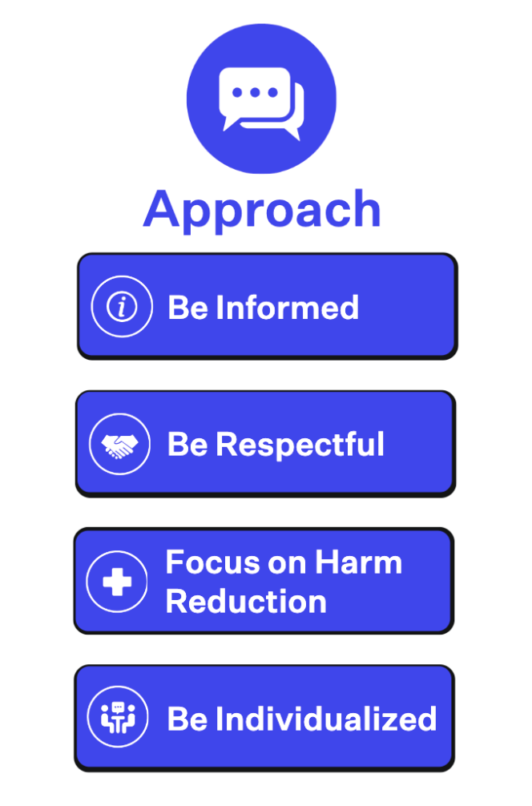
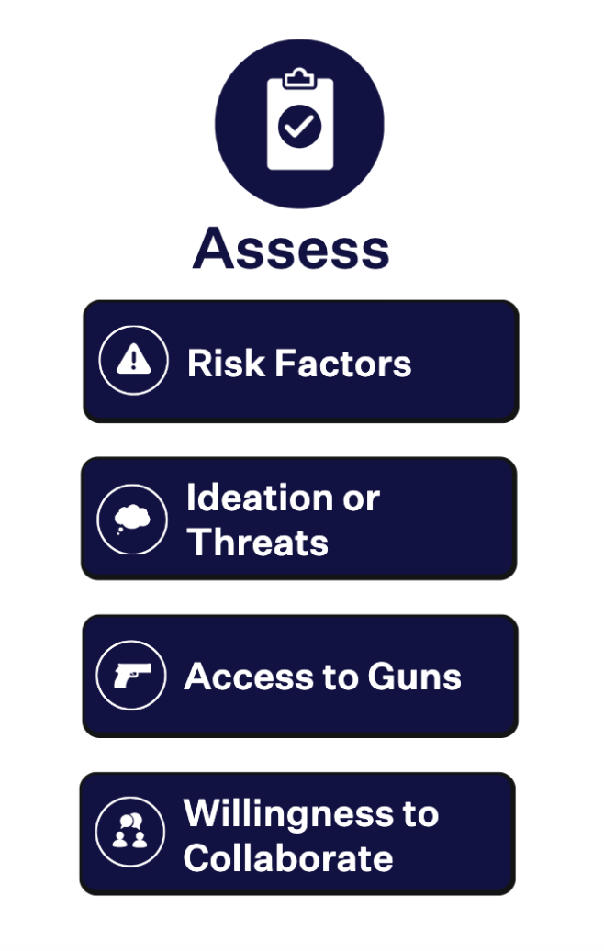
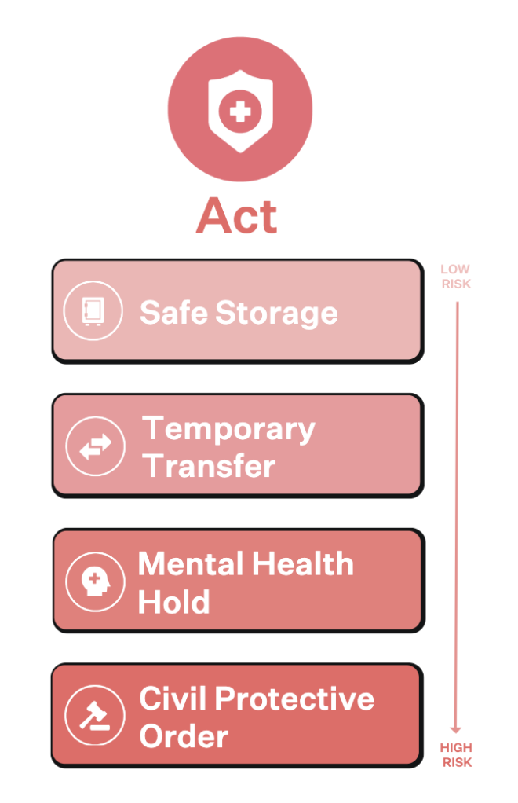
Approach

Slide 6
Approach
Be Informed
Know why people own firearms and the basics of firearms, safe storage, and local policies
Be Respectful
Respect a patient’s decision to own firearms and recognize that ownership may be an important part of a patient’s identity
Focus on Harm Reduction
As a clinician, your role is to keep patients as safe and healthy as possible
Reducing some risk is better than not reducing any risk
Be Individualized
Find an individualized solution that works for your patient

Slide 7
Be Informed: Language Matters
“Secure storage” or “safe storage” when talking about storage (rather than “gun safety”)
“Reducing access” when talking about making guns inaccessible to those who should not have access
“Temporary” and “voluntary” when talking about options for getting guns out of home “during times of crisis or risk”
When possible, “voluntary and collaborative”

Slide 8
Approach

Slide 9
Assess
Risk Factors
Several factors increase the risk of suicide or interpersonal violence to patients or others
Ideation or Threats
Certain situations are always considered higher-risk, if a patient
has thoughts about harming themselves or someone else, or
has made threats to hurt themselves or someone else
Access to Guns
If ideation, threats, or other risk factors are present, it’s relevant to ask about access to firearms
Willingness to Collaborate
If a patient is at risk and has access to firearms, assess their ability and willingness to collaborate

Slide 10
Risk Factors
Individual risk factors
Certain psychiatric disorders like depression, bipolar disorder, or schizophrenia
Substance misuse, especially alcohol and stimulants
History of suicide attempts
History of violence
Intimate partner violence or domestic abuse
Dementia or other cognitive impairment
Recent relationship or job loss
Storing guns in a way that they are easily accessible to at-risk people
Chesney et al. 2014; Swanson et al. 2015; Branas et al. 2016; Wintemute et al. 2018; McKetin et al. 2014; McGinty et al. 2016; Hawton et al. 2006; Wintemute et al. 1998; Rowhani-Rahbar et al. 2015; Cunningham et al. 2015; Zeoli et al. 2016; Bailey et al. 1997; Rosen et al. 2019; Liljegren et al. 2015; Campbell et al. 2003; Grossman et al. 2005; Monuteaux et al. 2019.

Slide 11
Youth and Firearms
Children in the home are at elevated risk of unintentional injury
You should always ask about firearm access and storage when there are children in the home

Slide 12
Approach

Slide 13
Act
Safe Storage
Temporary Transfer of Firearms
Mental Health Holds
Civil Protective Orders

Slide 14
Act
Refer to Educators Toolkit slide sets:
Safe Firearm Storage
Firearm Injury Prevention Intervention Options
Notes:
Add in links?

Slide 15
Learn more
How to counsel:
https://www.bulletpointsproject.org/how-to-counsel/
Approach - https://www.bulletpointsproject.org/how-to-counsel/#approach
Assess - https://www.bulletpointsproject.org/how-to-counsel/#assess
Act - https://www.bulletpointsproject.org/how-to-counsel/#act
Firearm injury prevention intervention options:
https://www.bulletpointsproject.org/interventions/
Firearm-related harm due to – suicide, unintentional injury, intimate partner violence, mass shootings, dementia, community violence, and recurrent injury:
https://www.bulletpointsproject.org/clinical-scenarios/

Slide 16
References
Bailey, J.E., Kellermann, A.L., Somes, G.W., et al. (1997). Risk Factors for Violent Death of Women in the Home. Archives of Internal Medicine. 157(7):777-782.
Branas, C.C., Han, S., & Wiebe, D.J. (2016). Alcohol Use and Firearm Violence. Epidemiologic Reviews. 38(1):32-45.
Chesney, E., Goodwin, G.M., & Fazel, S. (2014). Risks of all-cause and suicide mortality in mental disorders: a meta-review. World Psychiatry. 13(2):153-160.
Campbell, J. C., Webster, D., Koziol-McLain, J., et al. (2003). Risk factors for femicide in abusive relationships: results from a multisite case control study. American Journal of Public Health. 93(7):1089-1097.
Cunningham, R. M., Carter, P. M., Ranney, M., et al. (2015). Violent Reinjury and Mortality Among Youth Seeking Emergency Department Care for Assault-Related Injury: A 2-Year Prospective Cohort Study. JAMA Pediatrics. 169(1):163-170.
Grossman, D. C., Mueller, B. A., Riedy, C., et al. (2005). Gun storage practices and risk of youth suicide and unintentional firearm injuries. JAMA. 293(6):707-714.
Hawton, K., Harriss, L., & Zahl, D. (2006). Deaths from all causes in a long-term follow-up study of 11,583 deliberate self-harm patients. Psychological Medicine. 36(3):397-405.
Liljegren, M., Naasan, G., Temlett, J., et al. (2015). Criminal behavior in frontotemporal dementia and Alzheimer disease. JAMA Neurology. 72(3):295-300.
McGinty, E. E., Choksy, S., & Wintemute, G. J. (2016). The Relationship Between Controlled Substances and Violence. Epidemiologic Reviews. 38(1):5-3.
McKetin, R., Lubman, D.I., Najman, J.M., et al. (2014). Does methamphetamine use increase violent behaviour? Evidence from a prospective longitudinal study. Addiction. 109(5):798-806.
Monuteaux, M. C., Azrael, D., & Miller, M. (2019). Association of Increased Safe Household Firearm Storage With Firearm Suicide and Unintentional Death Among US Youths. JAMA Pediatrics. 173(7):657-662.
Rosen, T., Makaroun, L.K., Conwell, Y., et al. (2019). Violence In Older Adults: Scope, Impact, Challenges, And Strategies For Prevention. Health Affairs. 38(10):1630-1637.
Rowhani-Rahbar, A., Zatzick, D., Wang, J., et al. (2015). Firearm-related hospitalization and risk for subsequent violent injury, death, or crime perpetration: a cohort study. Annals of Internal Medicine. 162(7):492-500.
Swanson, J.W., McGinty, E.E., Fazel, S., et al. (2015). Mental illness and reduction of gun violence and suicide: bringing epidemiologic research to policy. Annals of Epidemiology. 25(5):366-376.
Wintemute, G. J., Drake, C. M., Beaumont, J. J., et al. (1998). Prior misdemeanor convictions as a risk factor for later violent and firearm-related criminal activity among authorized purchasers of handguns. JAMA. 280(24):2083-2087.
Wintemute, G.J., Wright, M.A., Castillo-Carniglia, A., et al. (2018). Firearms, alcohol and crime: convictions for driving under the influence (DUI) and other alcohol-related crimes and risk for future criminal activity among authorised purchasers of handguns. Injury Prevention. 24(1):68–72.
Zeoli, A. M., Malinski, R., & Turchan, B. (2016). Risks and Targeted Interventions: Firearms in Intimate Partner Violence. Epidemiologic Reviews. 38(1):125-139.

