Slide 1
Educators Toolkit – Epidemiology of Firearm Injury

Slide 2

Epidemiology of Firearm Injury

Slide 3

Firearm Homicide and Suicide Rates by Country, 2010
Data from Grinshteyn & Hemenway 2016
Notes:
Firearm-related injuries are a major cause of death in the United States and this problem is unique to the US. This graph shows that the US has the highest rates of firearm homicide and firearm suicide among high-income countries.

Slide 4
Death Rates from Motor Vehicle Crashes and Firearms by Year 1950-2020
Data from CDC WISQARS. Firearm deaths include homicides and suicides only.
Notes:
This graph compares two public health issues in the US over the past 70 years: firearm violence and motor vehicle crashes. The death rate from motor vehicle crashes used to be much higher, but has consistently dropped due to the large-scale mobilization of funding, research, and safety interventions. In contrast, until very recently, there were few investments in firearm injury prevention research at the federal level. As a result, deaths from firearms have largely stayed the same since the 1950s, and surpassed motor vehicle deaths in 2017 for the first time in history.

Slide 5
Firearm Deaths in US by Intent, 2020
Less than 1% of firearm homicides occur in public mass shootings
45,222 firearm deaths in 2020
Data from CDC WISQARS & Follman, Aronsen, & Pan 2021
Notes:
In 2020, the most recent year for which we have data, there were over 45,000 firearm-related deaths. Most firearm deaths are suicides and beginning in 2020 there has been an increase in deaths from firearm homicide. A small proportion are unintentional deaths or deaths of undetermined intent. Among firearm homicides, less than 1% are mass shootings in which 3 or more people died in a public place. These comprise 0.2% of firearm deaths overall.
(A public mass shooting is defined as a single attack in a public place in which 3+ victims were killed, not including the perpetrator(s), and excluding shootings stemming from more conventionally motivated crimes such as armed robbery or gang violence.)

Slide 6
Firearm Homicide Rates by Age and Race/Ethnicity Males, 2020
Data from CDC WISQARS. Homicides do not include deaths by legal intervention.
Notes:
This graph shows rates of firearm homicide among men across the life course, stratified by race/ethnicity. In older teens and young men, deaths come to a peak at 24, especially for African American males.

Slide 7
Firearm Homicide Rates by Age and Race/Ethnicity Females, 2020
Data from CDC WISQARS. Homicides do not include deaths by legal intervention.
Notes:
In general, rates of firearm deaths of all intents are much lower among women. For firearm homicide, females have similar patterns to males by race/ethnicity, but notice that the y-axis has changed from a maximum of over 100 deaths per 100,000 for males to 16 per 100,000 for females.

Slide 8
Firearm Suicide Rates by Age and Race/Ethnicity Males, 2020
Data from CDC WISQARS
Notes:
For firearm suicide, we see a very different pattern. Risk of firearm suicide continues to increase with age and is concentrated among white men. From age 50 onward, the firearm suicide rate for white males is at least 3 times that for Black or Hispanic males.

Slide 9
Firearm Suicide Rates by Age and Race/Ethnicity Females, 2020
Data from CDC WISQARS
Notes:
In general, rates of firearm suicide among women are lower than those for men. Rather than increasing with age, suicide risk generally peaks in middle age and then declines.

Slide 10
Suicide Attempts by Method
Firearm 5%
Data from Connor, Azrael, & Miller 2019

Slide 11
Suicide Deaths by Method
85-90%
of suicide attempts by firearm are fatal
Data from Connor, Azrael, & Miller 2019

Slide 12
Firearm Death Rates by Age and Intent Children & Adolescents, 2020
Data from CDC WISQARS. Homicides do not include deaths by legal intervention.
Notes:
Among children and adolescents, deaths from unintentional firearm injuries remain low and stable through age 21, while rates of firearm homicide and suicide both begin to increase around age 12. Firearm suicide is slightly more common in the pre-teen and early teenage years and firearm homicide becomes more common around age 15.

Slide 13
Nonfatal Firearm Injuries in US by Intent 2009-2017
85,694 ED visits for nonfatal firearm injuries per year on average
9 in 10 suicide attempts with a firearm are fatal
Data from Kaufman et al. 2020
Notes:
For every person who dies from a firearm injury, there are another 2 who are shot and survive. Using emergency department data, researchers estimate that there are about 85,000 nonfatal firearm injuries each year. These injuries look different than firearm deaths. Most notably, while only 1% of firearm deaths are unintentional, 51% of nonfatal firearm injuries are unintentional. Notably, 9 in 10 suicide attempts with a firearm are fatal.

Slide 14
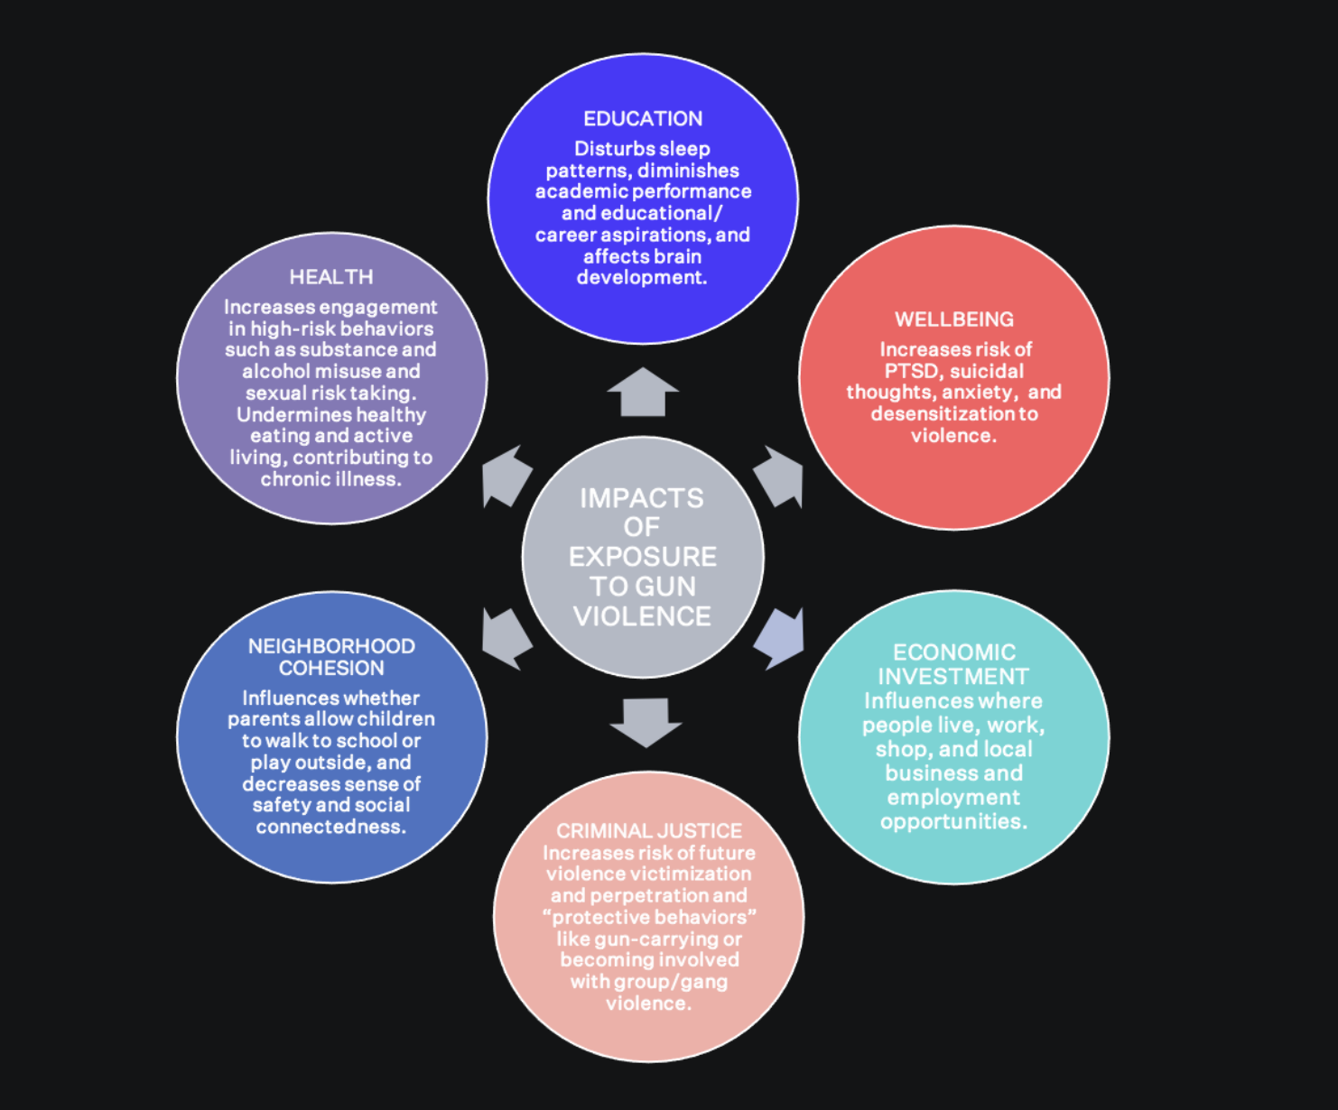
Socioemotional Consequences
Image adapted from the Violence Policy Center
Notes:
Exposure to gun violence is associated with numerous adverse effects on the health and well-being of individuals and communities.

Slide 15
Learn more
Epidemiology of firearm injury:
https://www.bulletpointsproject.org/epidemiology/
Firearm-related harm due to – suicide, unintentional injury, intimate partner violence, mass shootings, dementia, community violence, and recurrent injury:
https://www.bulletpointsproject.org/clinical-scenarios/
Social determinants of health and cultural humility:
https://www.bulletpointsproject.org/social-determinants-of-health/
https://www.bulletpointsproject.org/cultural-humility/

Slide 16
References
CDC. WISQARS (Web-based Injury Statistics Query and Reporting System). Available from: https://www.cdc.gov/injury/wisqars/index.html.
Conner, A., Azrael, D., Miller, M. (2019) Suicide Case-Fatality Rates in the United States, 2007 to 2014: A Nationwide Population-Based Study. Annals of Internal Medicine. 171(12):885-895.
Follman, M., Aronsen, G., & Pan, D. (2021). US Mass Shootings, 1982-2021: Data From Mother Jones’ Investigation. Mother Jones.
Grinshteyn, E., Hemenway, D. (2016). Violent Death Rates: The US Compared with Other High-income OECD Countries, 2010. American Journal of Medicine. 129(3):266-273.
Kaufman, E.J., Wiebe, D.J., Xiong, R.A., et al. (2021). Epidemiologic Trends in Fatal and Nonfatal Firearm Injuries in the US, 2009-2017. JAMA Internal Medicine 181(2):237-244.

