Slide 2

Firearm Injury Prevention Interventions

Slide 3
The Clinician’s Role
Assess risk and, when it’s clinically relevant, talk with patients about risk and firearms, and take action to reduce risk.
There are no state or federal statutes that prohibit clinicians from talking with patients about access to firearms.

Slide 4
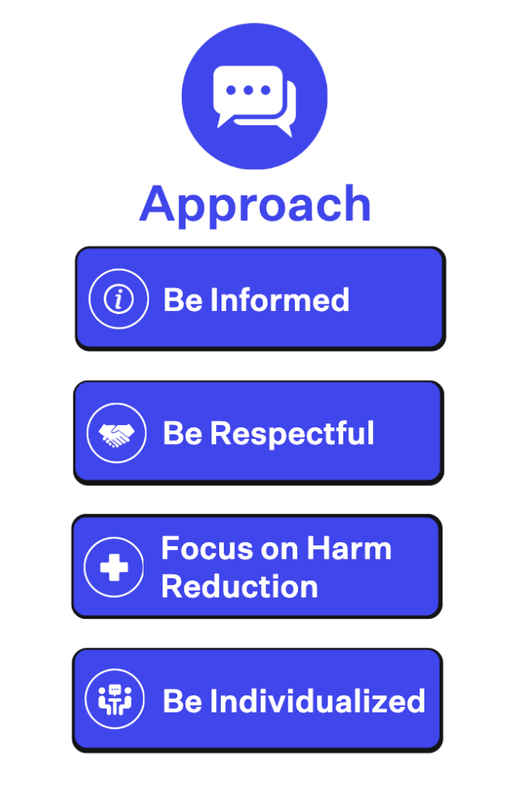
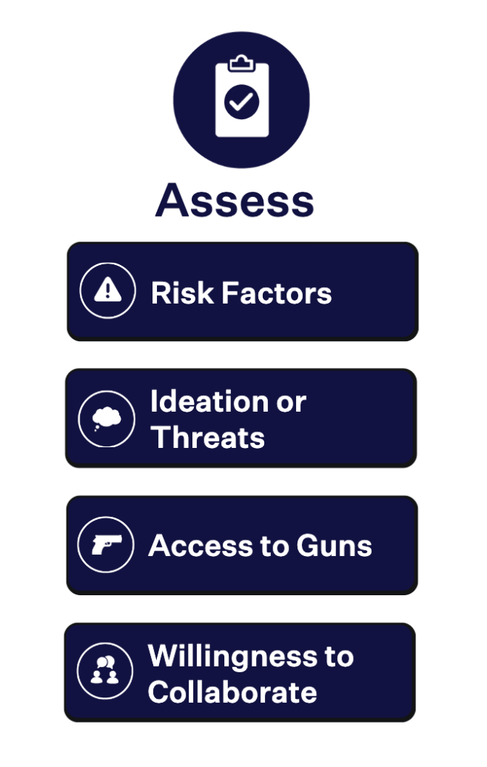
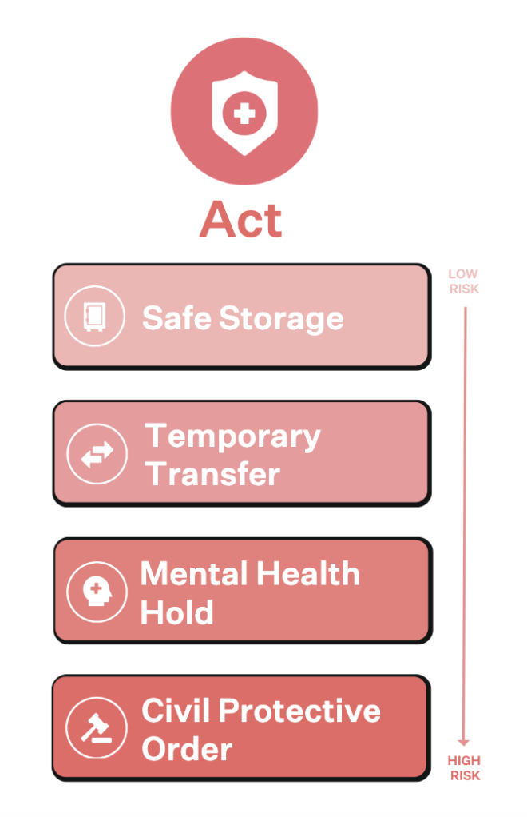
The 3A’s Framework for Firearm Injury Prevention Counseling

Slide 5

When no one is at imminent risk, safe storage is the appropriate recommendation
Notes:
See Educators Toolkit slide set on Safe Storage for further information.

Slide 6

Temporary Transfers
Used when removing firearms from the home is the safest option, and the person is willing to collaborate
Temporary transfer to family or other trusted person
  Background check requirements vary
  In some places, these policies are in flux
Temporary, voluntary storage at a gun range, store, or with a law enforcement agency
  In some places, there may be a cost associated with storage
  Some states have online maps that show which businesses and agencies offer temporary firearm storage

Slide 7
Emergency Interventions
If a patient at high risk is not willing to collaborate, emergency interventions may be necessary to prevent harm
If the person needs mental health treatment, consider a mental health hold
If the person is not willing to relinquish their firearms, consider Civil Protective Orders for temporary, involuntary removal of guns
These two are not mutually exclusive
Notes:
AB

Slide 8
Mental Health Holds
Involuntary psychiatric hold for dangerousness to self or others
In emergency situations, mental health holds can bring someone at risk of harming themselves or others into mental health treatment
An emergency mental health hold or even a hospitalization does not guarantee the person won’t have continued firearm access

Slide 9
Civil Protective Orders
Many states have civil protective orders for domestic violence
A growing number of states have extreme risk protection orders specifically for preventing violence and suicide with firearms
Other types of civil restraining orders, like workplace or school violence prevention orders, may be available for specific situations
Many but not all orders will include firearm relinquishment or removal at various times during the order

Slide 10
Extreme Risk Protection Orders (ERPOs)
Allow family members or police to petition to have a person’s guns removed based on a concern for violence and suicide in the near future
Modelled closely after Domestic Violence Restraining Orders
No mental health evaluation or history required!
No criminal activity required

Slide 11
Learn more
How to counsel:
https://www.bulletpointsproject.org/how-to-counsel/
Safe storage:
https://www.bulletpointsproject.org/safe-firearm-storage-devices/
Temporary transfers:
https://www.bulletpointsproject.org/temporary-firearm-transfers/
Mental health holds:
https://www.bulletpointsproject.org/mental-health-holds/
Civil protective orders:
https://www.bulletpointsproject.org/civil-protective-orders/

