Slide 2

Safe Firearm Storage

Slide 3

When no one is at imminent risk, safe storage is the appropriate recommendation

Slide 4
Importance of Safe Firearm Storage
Many firearm owners take safe storage very seriously and consider it a key tenet of firearm ownership
However, fewer than half of owners nationwide store all firearms in the most safe manner
Not storing firearms safely may result in access by unauthorized household members
Research has shown that, although many parents assume children are unaware of firearms in the home, children often know where guns are kept and have handled them without their parents’ knowledge
Crifasi et al. 2018; Baxley & Miller 2006

Slide 5
What You Can Do
Clinicians should talk through safe storage options with patients to find the device(s) that will work best for the patient’s preferences and needs and the degree of risk at home
The most appropriate locking device may depend on the type of firearm to be secured and the patient’s intended use
Storing guns in the safest manner may not be realistic for some gun owners, especially those who wish to keep their firearm quickly accessible for self-protection
  Clinicians should work with the patient to identify acceptable ways to reduce harm, for example, by storing their loaded firearm in a quick-access lock box

Slide 6
The safest way to store a firearm:
Unloaded
Locked up using a locking device
Separate from ammunition
With keys and combinations inaccessible to children and others at risk

Slide 7
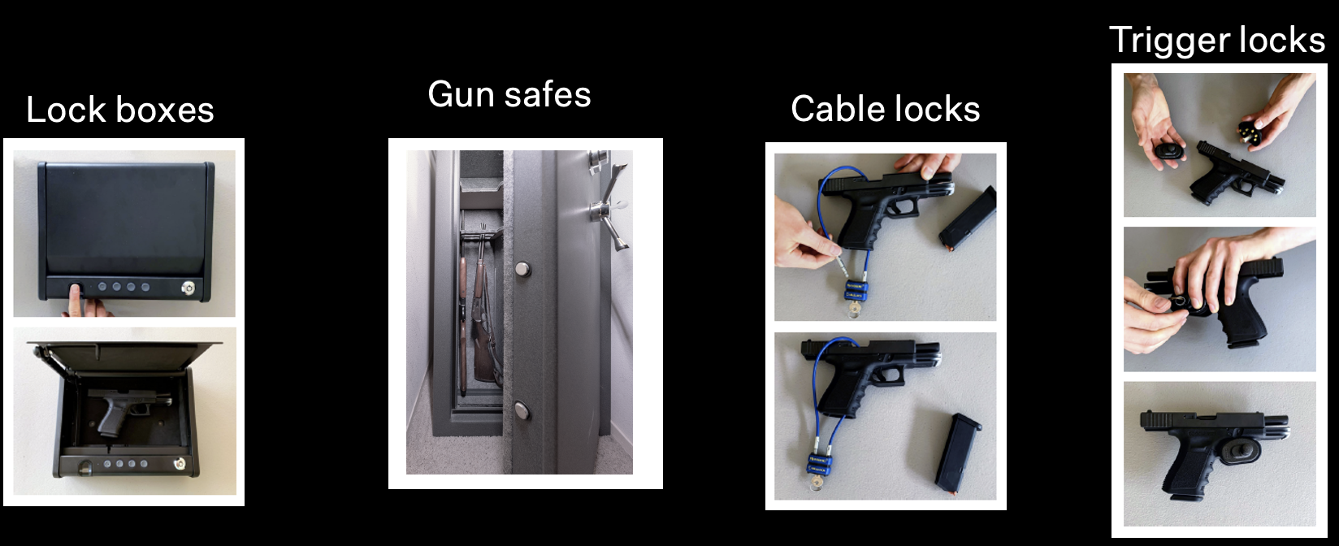

Safe storage devices
Options vary (by types & numbers of guns, uses, preferences)

Slide 8
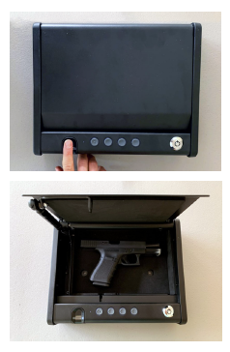

Lock boxes
Secure one firearm, with different size boxes for different firearms
Can have keys, combinations, or biometric technology
Allow quick access to firearm
Keep firearms out of sight
Are portable

Slide 9
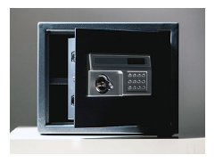
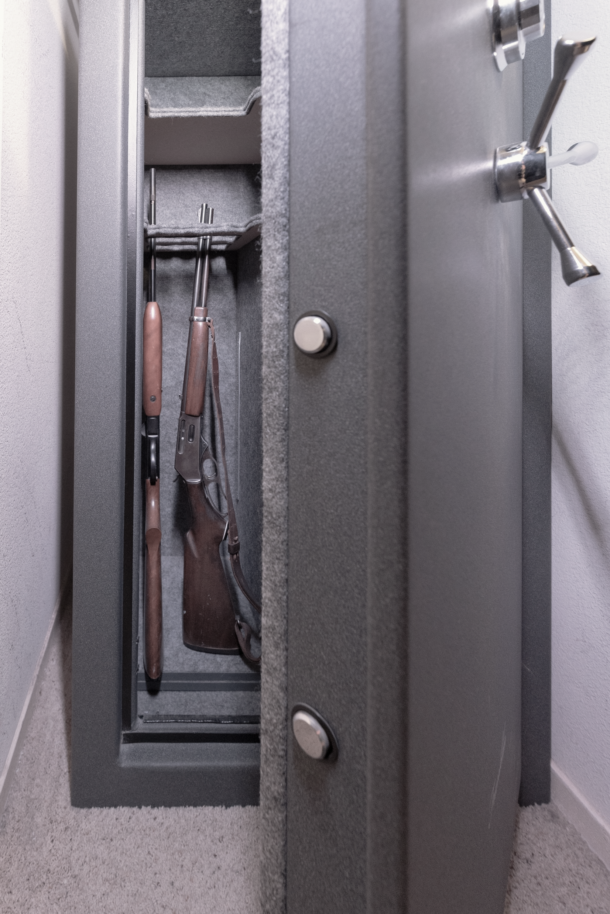
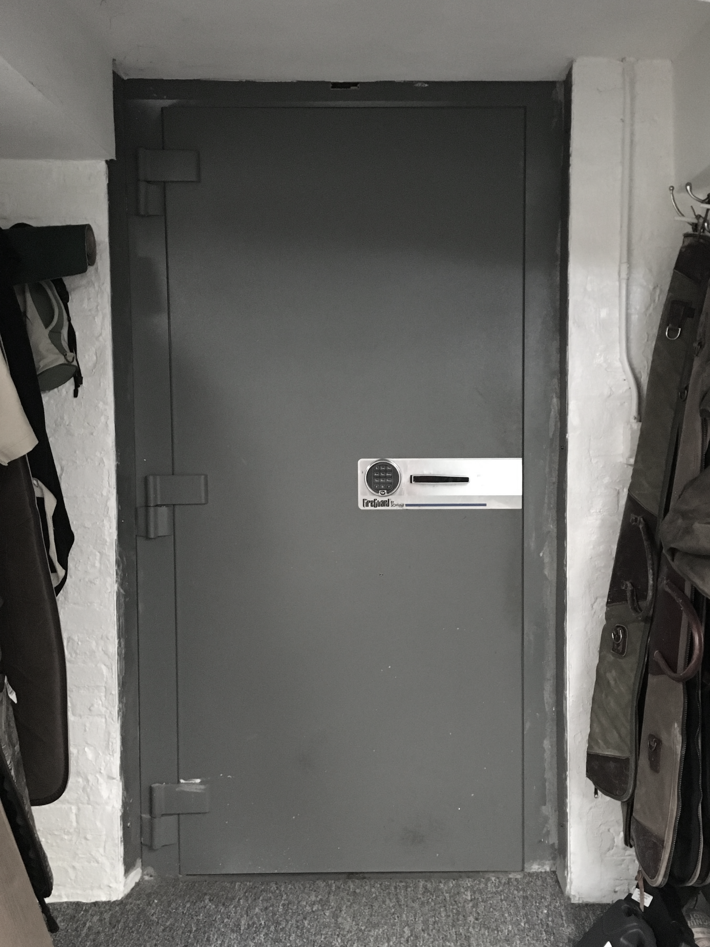
Gun safes
Secure multiple firearms, with different size safes for individual needs
Can have keys, combinations, or biometric technology
Keep firearms securely locked inside
Not portable
More expensive

Slide 10
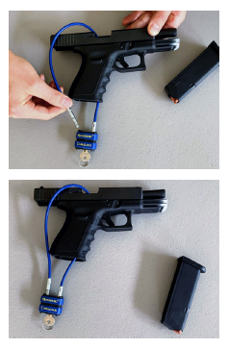
Cable locks
Render firearm temporarily unusable by inserting a steel cable through the firing mechanism and locking it to prevent gun from being fired
Often secured with a lock and key
Inexpensive and often available for free from law enforcement, gun stores, and hospitals
Don’t keep firearm out of sight or prevent theft

Slide 11
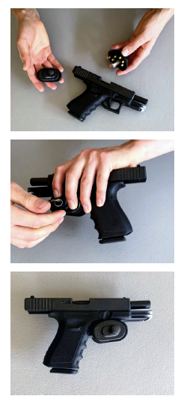
Trigger locks
Block trigger from being pulled by inserting the lock’s post through the trigger guard and locking it
Usually secured with a lock and key or combination
Don’t keep firearm out of sight or prevent theft
* It’s important to make sure the gun is unloaded when using a trigger lock. Putting a trigger lock on a loaded gun could cause it to fire.

Slide 12
Learn more
How to counsel:
https://www.bulletpointsproject.org/how-to-counsel/
Safe storage:
https://www.bulletpointsproject.org/safe-firearm-storage-devices/
Firearm-related harm due to – suicide, unintentional injury, intimate partner violence, mass shootings, dementia, community violence, and recurrent injury:
https://www.bulletpointsproject.org/clinical-scenarios/

Slide 13
References
Baxley, F., & Miller, M. (2006). Parental Misperceptions About Children and Firearms. Archives of Pediatric and Adolescent Medicine. 160(5):542-547.
Crifasi, C. K., Doucette, M. L., McGinty, E. E., et al. (2018). Storage Practices of US Gun Owners in 2016. American Journal of Public Health. 108(4):532-537.

